Slide 1
CS 460 – Team 5 Proposal 12
Developing an Immersive Historical Experience using VR Technology and Unity Engine
Daniel Johnson (lead)
T. Avery eich
Asad ashur

Slide 2
Project Description
Research/Application Focus
Research will be performed on available VR technologies, including but not limited to the following devices: Oculus Rift, HTC Vive, and Samsung Gear VR.
The team will explore applications of virtual reality in a non-interactive environmental experience composed using the Unity Engine.
Technology and methodology will be documented and assessed for application to a historical/educational experience.
After one semester of research and prototyping, the team will finalize a functional experience and present their findings in the 2017 Student Research and Creative Endeavor Symposium

Slide 3
Requirements
Documentation of current VR technology and methodology.
Collaboration with VCD department for 3D modeling and animation.
Deployment of prototype scene to Samsung Gear VR.
Optional Features
Deployment of prototype scene to Oculus Rift.
Collaboration with third-party (museum) for user testing.

Slide 4

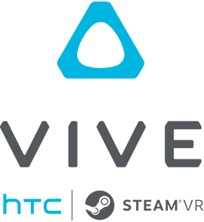



Resources

Slide 5
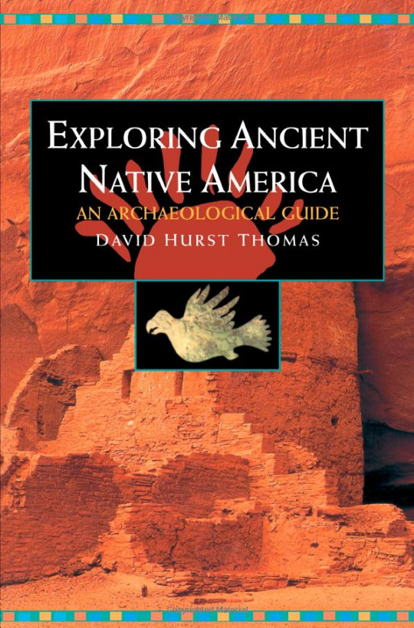
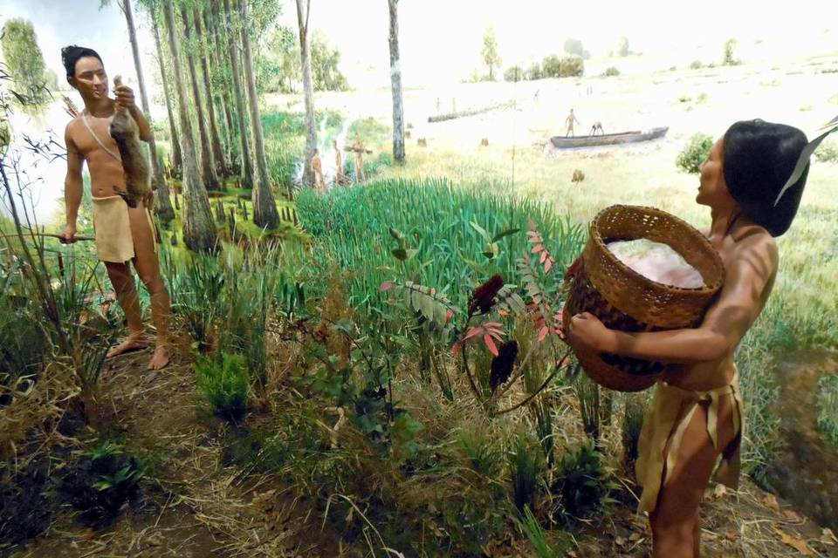
Historic references
Cahokia Mounds State Historic Site (Collinsville, IL)
Exploring Ancient Native America
(by David Hurst Thomas)

Slide 6
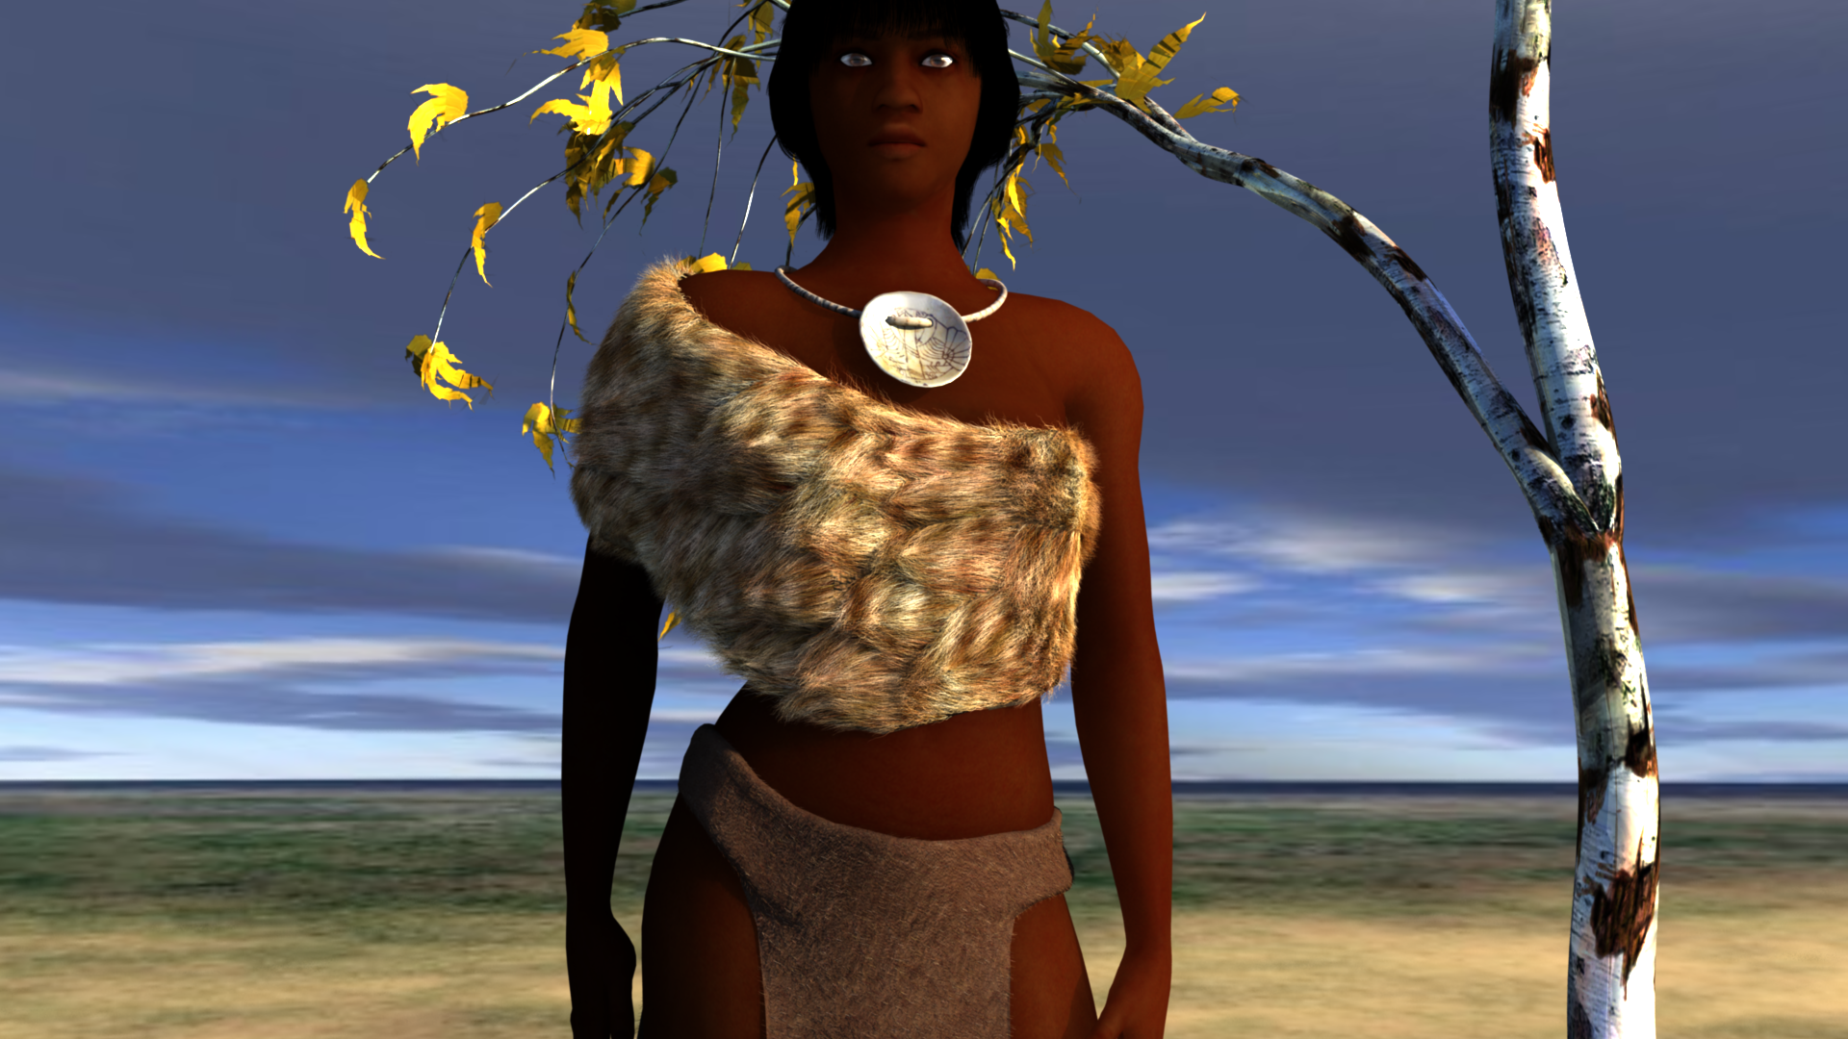
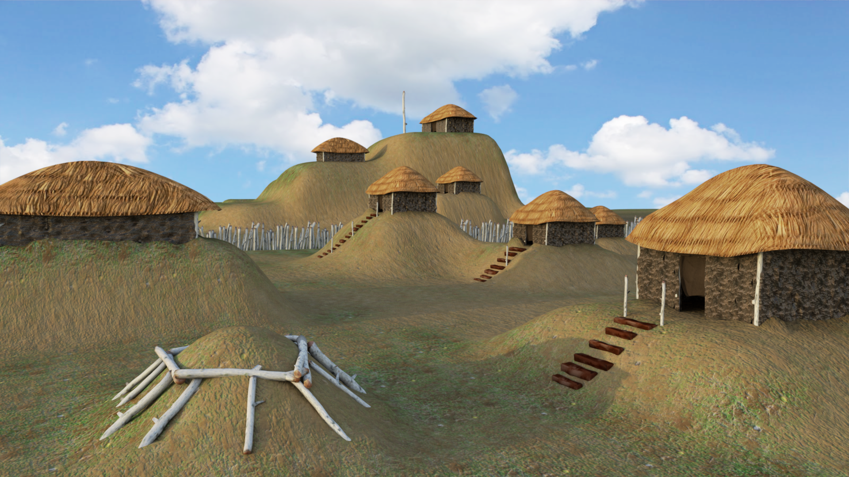
Visualizing Mississippian in a Living World
Unity3D Game Engine (5.3)

